Slide 1

ELECTROCARDIOGRAM HEARTBEAT CLASSIFICATION FOR THE DETECTION OF CARDIAC ARRHYTHMIA
CH.V.SIVA KUMAR REDDY
Supervised by
Dr.Jayanthi Ganapathy , Assistant Professor
IEEE Member ID : 98061135

Slide 2
ABSTRACT
Electrocardiogram(ECG) is a valuable clinical signal, which is widely used to identify cardiovascular diseases.
Electrocardiogram (ECG) can be reliably used as a measure to monitor the functionality of the cardiovascular system .

Slide 3
INTRODUCTION
Arrhythmia refers to an irregularity in the rate or rhythm of the heartbeat, This includes beating too fast or too slow or with an irregular rhythm.
I have used a classification model to classify the ECG in five different classes ( Non-ectopic beats ( normal beat ),Supraventricular ectopic beats , ventricular ectopic beats , Fusion beats , Unknown beats.

Slide 4
Data Overview
The Dataset has 2 CSV files , one containing samples for training and the other for testing.
The train.csv file has 87,554 samples.
The heartbeats in the dataset fall into 5 categories below
0 – Non-ectopic beats ( Normal Beat )
1 – Supraventricular ectopic beats
2 – Ventricular ectopic beats
3 – Fusion beats
4 – Unknown beats

Slide 5
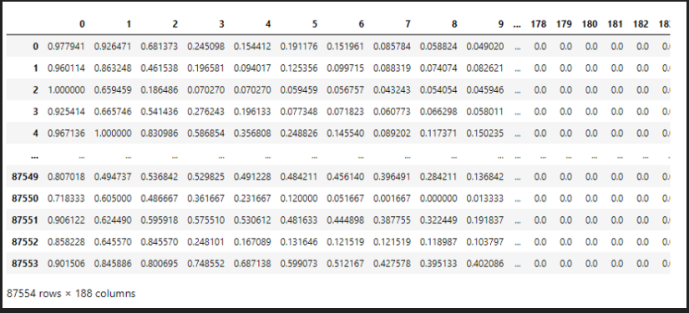
Train.csv

Slide 6
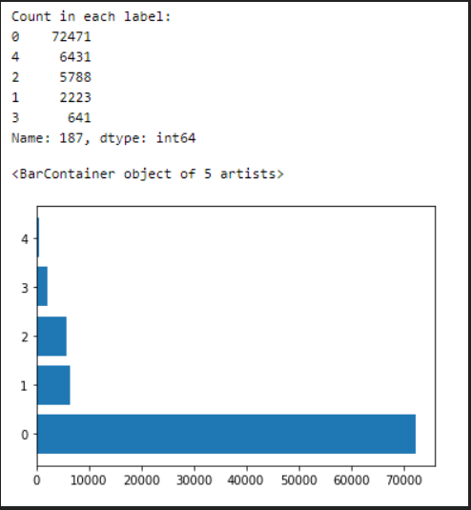
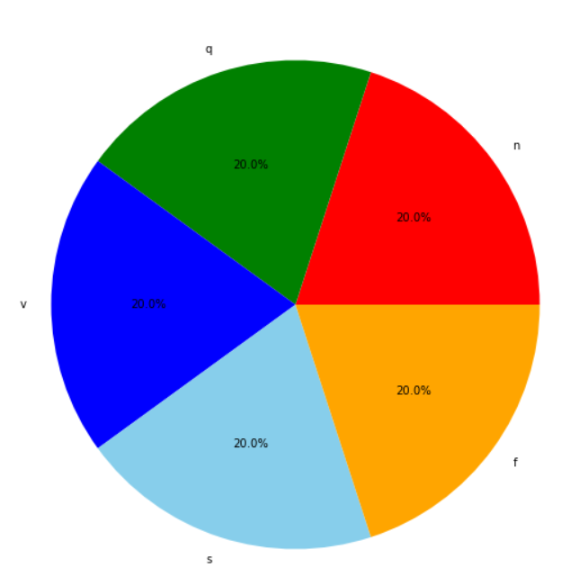
Spread of Samples across labels
Before Balancing the Dataset
After Balancing the Dataset

Slide 7
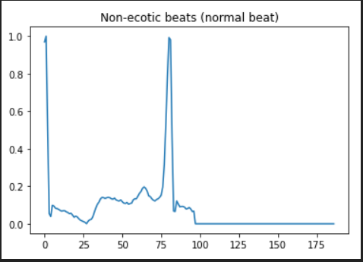
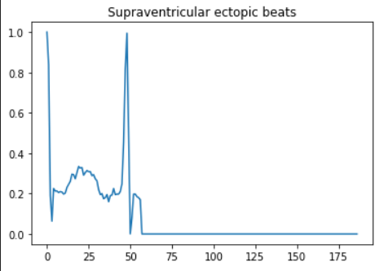
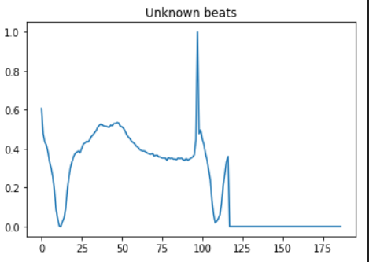
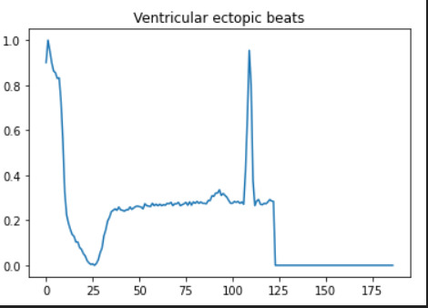
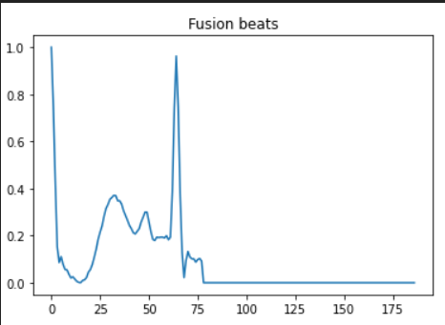
Different Classes of Arrhythmia

Slide 8
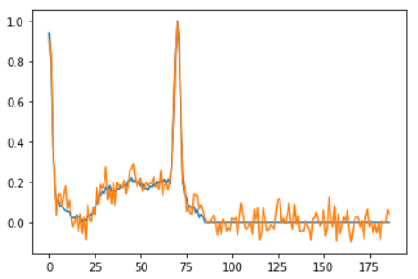

Preprocessing
Adding Noise :
Noise is added to the Data to mimic the external random process that can interfere in the data recording process . Adding Noise to the data to increase the efficiency of the trained model.

Slide 9

Preprocessing
One Hot Encoding:
The Class labels of the dataset are integers (0-4).Since this is a classification problem , the class labels are one hot encoded using the keras.utils.to_categorical function.

Slide 10
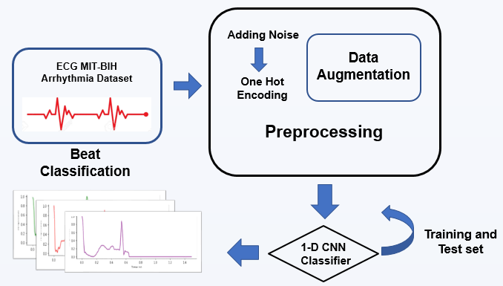
WORKFLOW

Slide 11
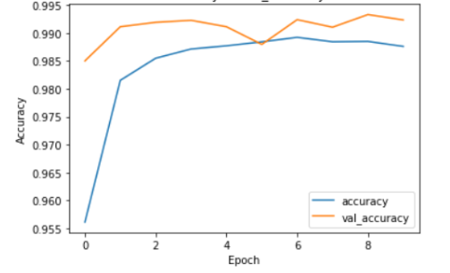
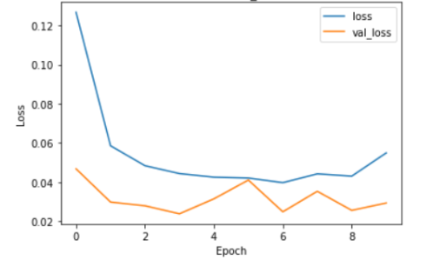
RESULTS
Accuracy v/s val_accuracy
Loss v/s val_loss

Slide 12
Conclusion
In this research, a deep learning one-dimensional CNN is proposed for automatic ECG heartbeat classification to classify five different types of arrhythmias. The performance of the proposed ECG heartbeat classification system has been verified from Physionet's MIT-BIH arrhythmia dataset.
As part of future work, our framework will be extended by implementing a 2-D CNN with ECG grayscale image input, which will be converted from ECG records from the MIT-BIH arrhythmia dataset.
.

Slide 13
REFERENCES
Jacopo Ferretti , Vincenzo Randazzo’s 1-D Convolutional Neural Network for ECG Arrhythmia Classification
Mohammad Mahmudur Rahman Khan’s ECG Heartbeat Classification Using CNN for the detection of Cardiac Arrhythmia

Slide 14
THANK YOU

